Slide 2
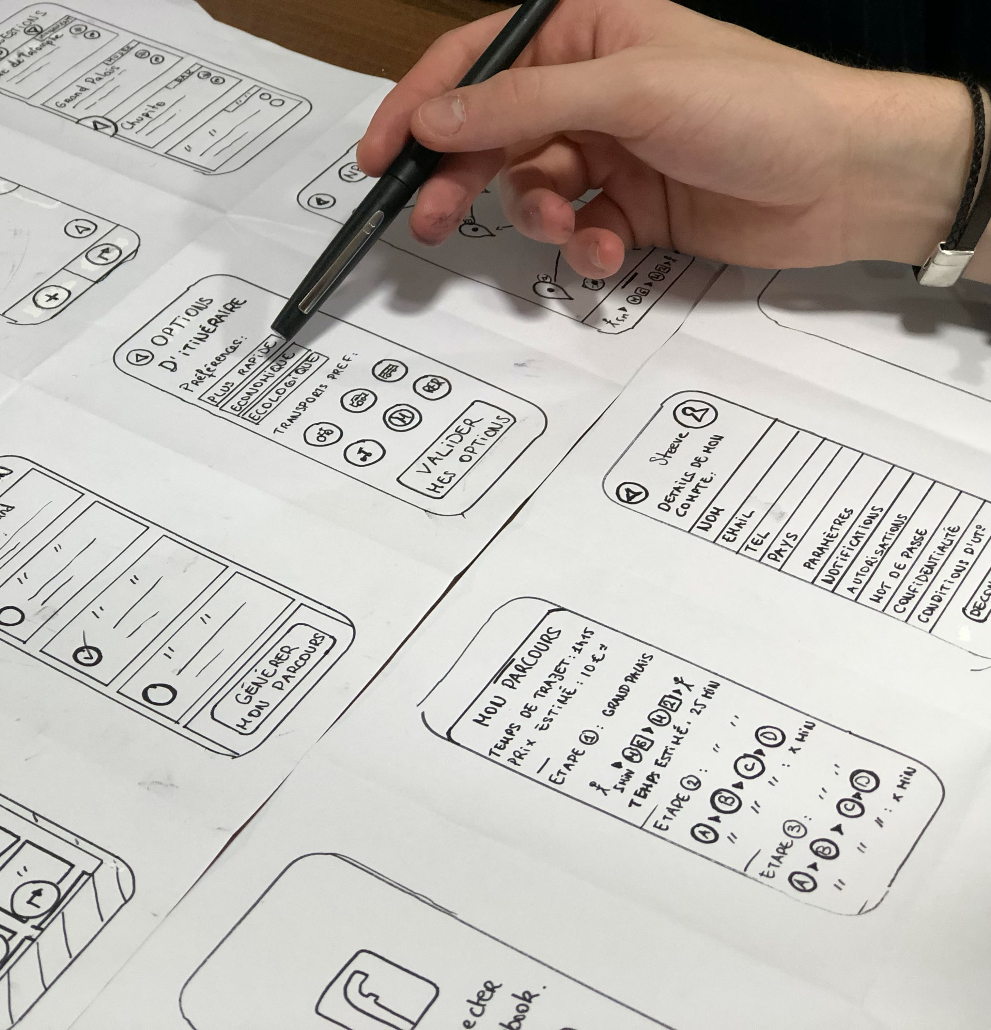

Future Iterations
Refine every aspect of the UI design principles during the low fidelity mock up stage
Create a Linear front to back design
Notes:
Design Image: https://unsplash.com/photos/sv8oOQaUb-o

Slide 3

Top 3 Issues
1. Unclear user flow
2. Clear information on webpages under construction
3. Some header bar links were broken
Notes:
Ensure that the complete user journey/flow of the website works. This is a severe problem because a user could get “stuck” on a certain place in the flow and become frustrated because the buttons that appeared to be clickable were not.
1.1 Solution: → ensure that the user flow can go from entering our website to the final booking page. Implement the connectivity of all checkout buttons/cart buttons.
2. Make the webpages that are under construction still contain a link to navigate the user to the homepage. The user may visit the page that is under construction and not know where to go from that page.
2.1 → added more information to the information statement so the user understand that the page does not function properly.
Go through the prototype of each page carefully.
3.1 Implement header buttons on each page and add a contact us page.
Citation: stressed Image: https://unsplash.com/photos/bmJAXAz6ads

Slide 4
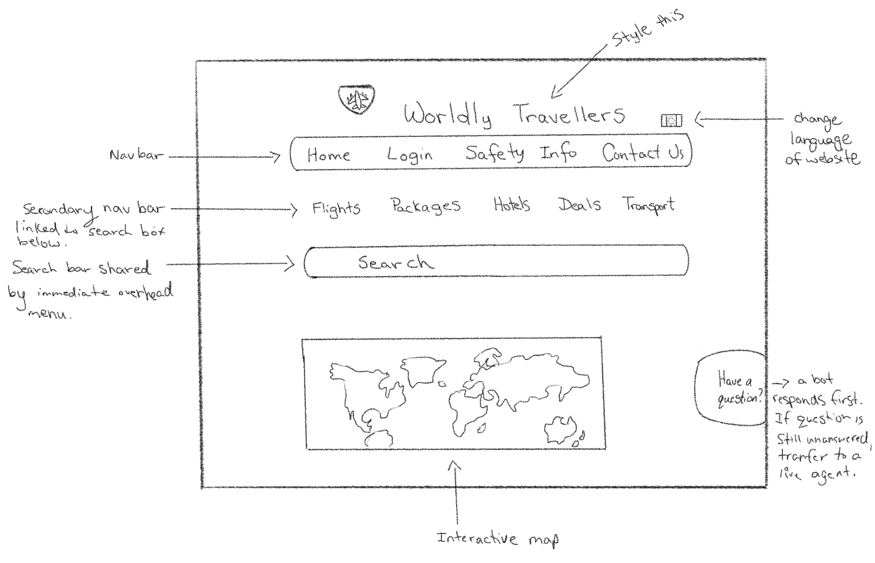
Refined Sketch 1
Notes:
Chosen sketch to iterate on: Simple UI design the utilizes grouping and sizing to adhere to the CRAP design principles.

Slide 5
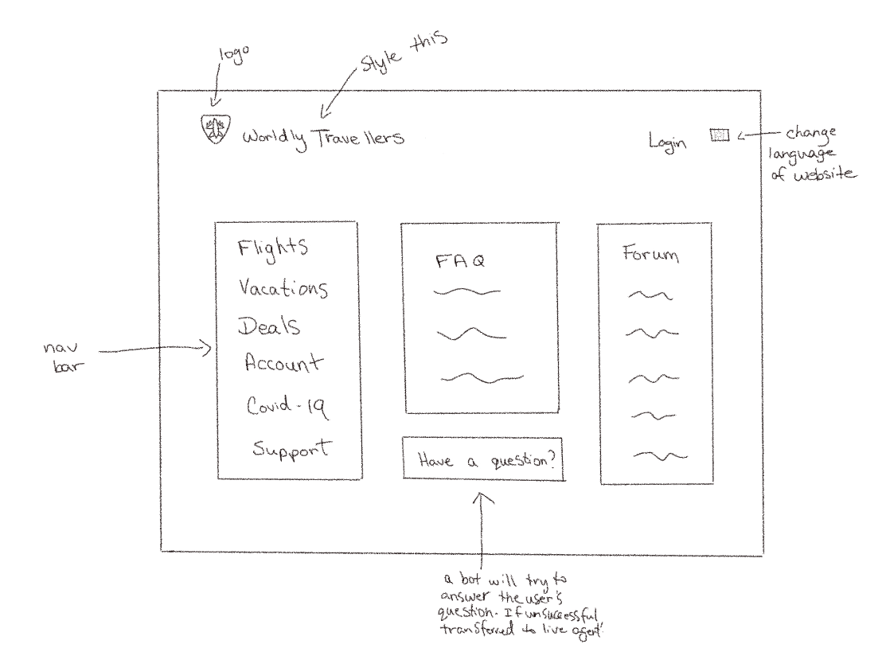
Refined Sketch 2
Notes:
Feels to rigid. Elements not grouped well. Does not draw the users focus to the most important elements.

Slide 6

Ideation Process
Brainstorming
Notes:
Sticky notes: https://unsplash.com/photos/m2TU2gfqSeE

